Slide 1
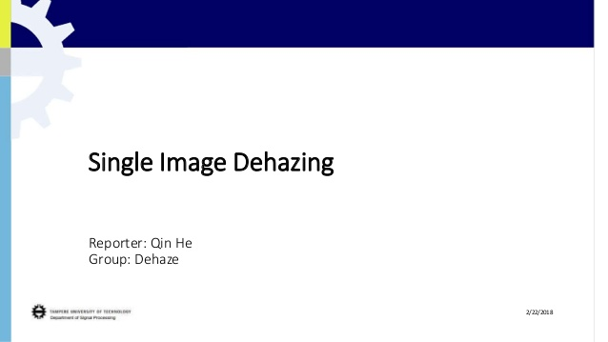

Slide 2
Goal: recover J,A and t from I
In computer vision and computer graphics, the model widely used in the formation of a hazy inage is :
I(x) = J(x)t(x)+A(1-t(x)),
Where I is the observed intensity, J is the scence radiance, A is the global atmospheric light, and t is the medium transmission describing the portion of the light that is not scatttered and reaches the camera.
The J(x)t(x) is the direct attenuation
the A(1-t(x)) s called airlight.

Slide 3
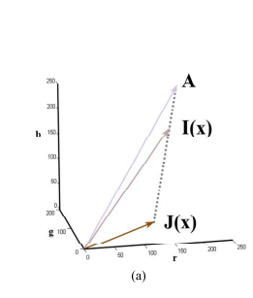

In the RGB color channel with index: c belongs to {r,g,b}
Geometrically, this means that in RGB color space, A, I(x) and J(x) are coplanar and their end points are collinear.

Slide 4
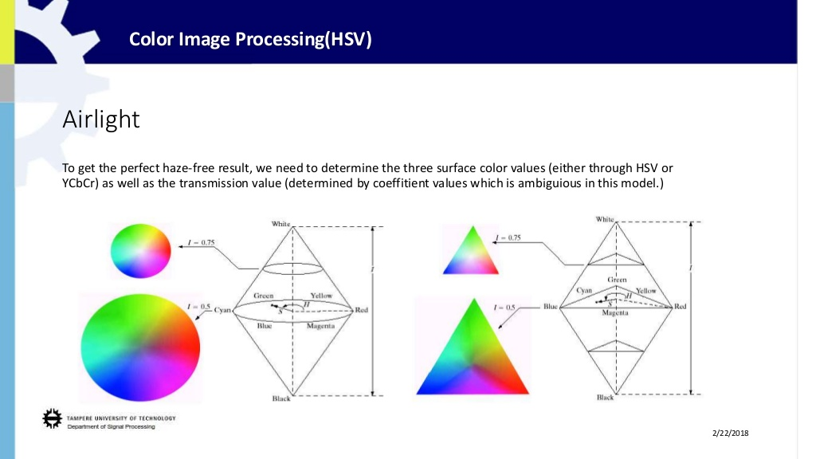
Atmosphere light

Slide 5


Dark Channel Prior:
In most of the nonsky patches, at least one color channel has some pixels whose intensity are very low and close to zero. Equivalently, the minimum intensity in such a patch is close to zero.
To formally describe the concept of the dark channel, for an arbirary image J, its dark channel is given by
Where J is a color channel of J and is a oxal patch centered at x. When the low intensity of J’s dark channel is low and tends to be zero.

Slide 6

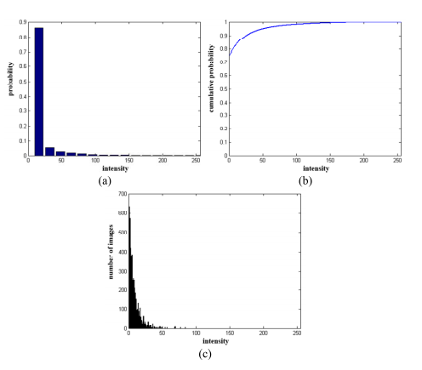
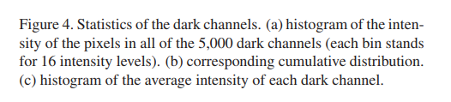

Slide 7



Haze Removal Using Dark Channel Prior:
After normalize each color channel independently, we assume that the transmission ina local parch is constant. Then we minimize it as:
As the scene radiance J is a haze-free image, the dark channel of J is close to zero due to the dark channel prior:
The final estimation of the transmission is: with still a very small amount of haze.

Slide 8



For the further generalization into multi channel, the I can be :
To minimize the cost function with soft matting:
To finally obtain the optimal t , the linear system can be soled with laplatian matrix:

Slide 9
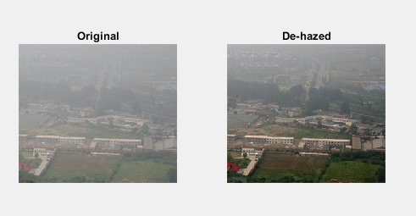
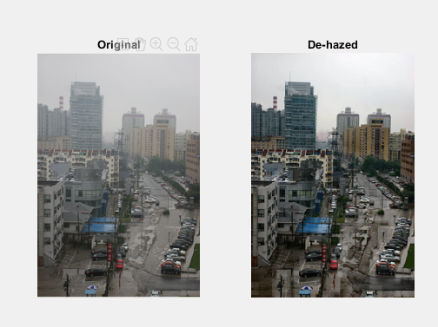
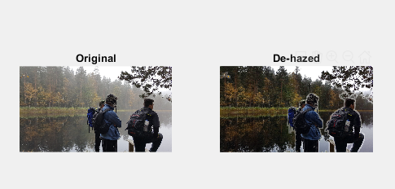

Slide 10

When the atmospheric Light is given the bintensity can be finally estimated by:
Algorithm:
First read the image x1,x2,…xn and normalize them separately.
Calculate the dark channel prior Jdark
Estimate the atmosphere light which can be measured.
Soft matting related to t0, and minimize the cost funtion
Get the finall radience J of the image as the formula (*) at the top.

Slide 11
Thank you!

